Slide 1

Vivekanand Education Society’s Institute Of Technology
Department Of Information Technology
Project Review I-Semester 5
Title: Goodwill Foundation
Domain: Web Development
Group Members: 4
Member1 :Nikita Chhabria-07
Member2: Dimple Dalwani-08
Member3: Nayaab Jindani -20

Slide 2
Content
Introduction to the project
Problem Statement
Objectives of the project
Requirements of the system (Hardware, software)
Front End
Implementation
Conclusion
References

Slide 3
Introduction to Project
Introduction to the Donation App Project :
Purpose: The Donation App aims to transform how people support charitable causes by making the donation process simple and transparent.
User-Friendly Platform: Offers an easy-to-use interface for discovering and contributing to various charitable initiatives.
Transparency and Efficiency: Provides detailed information about supported projects, ensuring that donations are impactful and reach the right places.
Increased Engagement: Designed to encourage donor involvement and foster a culture of giving within communities.
Ultimate Goal: To create a rewarding experience for donors and build a better future through collective generosity.
r Rates

Slide 4
Problem Statement
Lack of Transparency: Many donors are unsure where their money goes and how it's used, leading to hesitation in making contributions.
Difficulty Finding Trustworthy Organizations: Potential donors often struggle to identify reliable charities to support.
Cumbersome Donation Processes: The process of donating can be complicated and discouraging, deterring potential contributors.
Engagement Challenges for Charities: Charitable organizations often find it difficult to reach a broader audience and efficiently manage donations.
Our Donation App addresses these issues by creating a user-friendly platform that connects donors with verified charities, provides clear insights into the use of funds, and simplifies the donation process.
r Rates

Slide 5
Objectives of the project
Objectives
Increase Donation Transparency: Offer donors a clear view of how their funds are allocated and used, ensuring accountability and clarity.
Ease the Donation Process: Design an intuitive interface that simplifies the steps involved in making a donation, making it accessible for everyone.
Broaden Donor Connections: Facilitate connections with a diverse selection of trusted charitable organizations, enhancing the reach and support for various causes.
Enable Donation Monitoring: Provide features that allow donors to track their contributions and stay informed about the ongoing status and results of funded projects.
Boost Donor-Charity Interaction: Create opportunities for continuous engagement, encouraging a closer relationship and ongoing communication between donors and charities.
Guarantee Data Security: Ensure the highest level of security to protect users' sensitive information, fostering confidence in the safety and reliability of the donation process.

Slide 6
Requirements of the system (Hardware, software)
lem Statement
.
Hardware Requirements | Software Requirements
A Laptop or Desktop | Visual studio code
Processor: Core i3 or above | Mern stack
RAM:4GB | Github

Slide 7
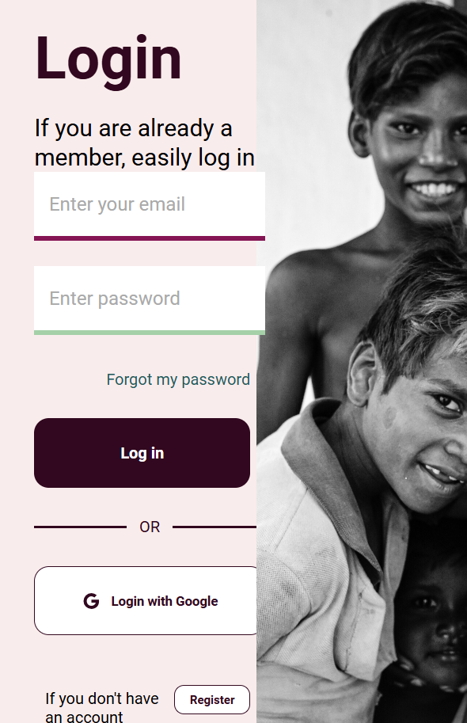
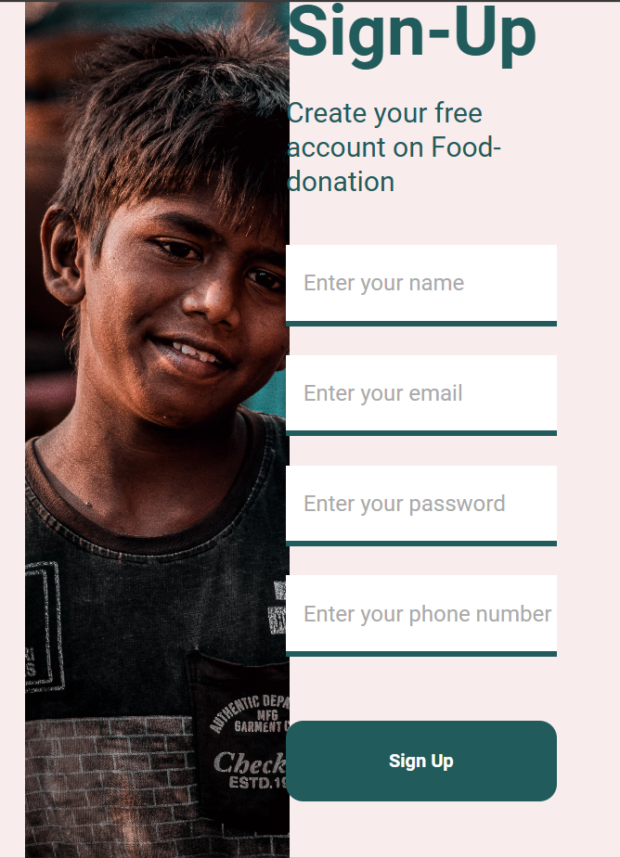
Implementation
Figure 8:Login Page
Figure 9:Signup Page

Slide 8
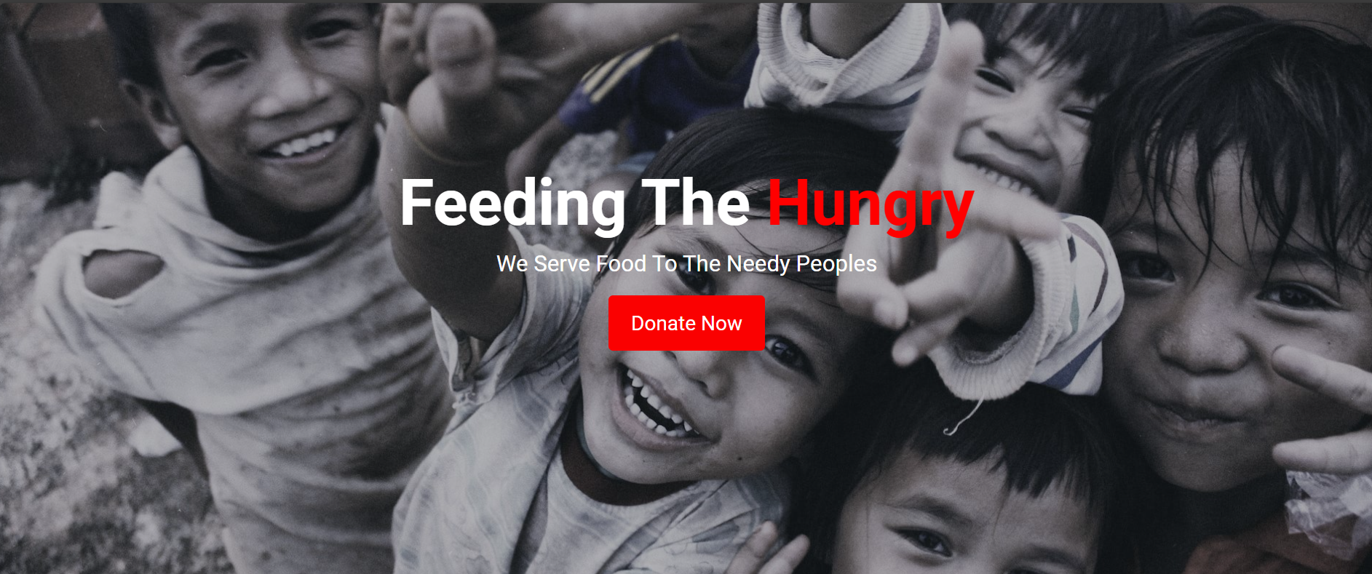
Implementation
Home page

Slide 9
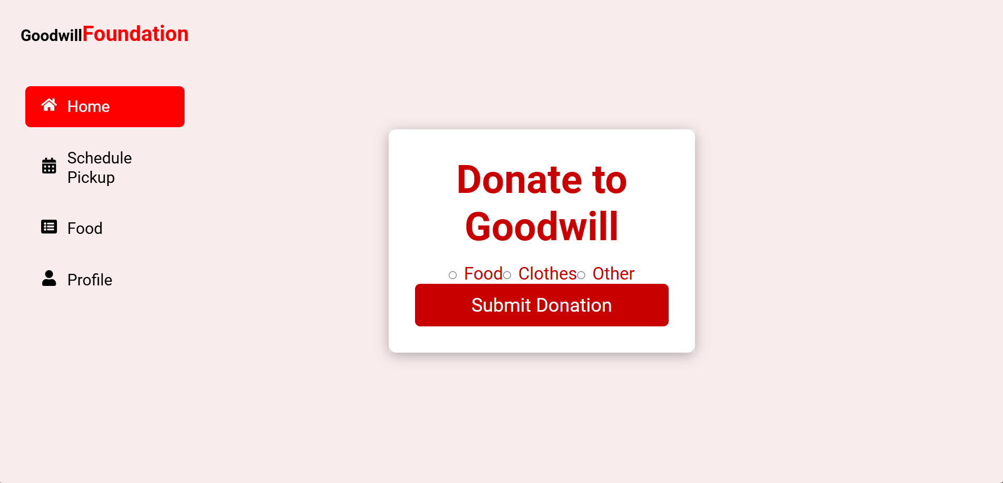
Donation Page

Slide 10
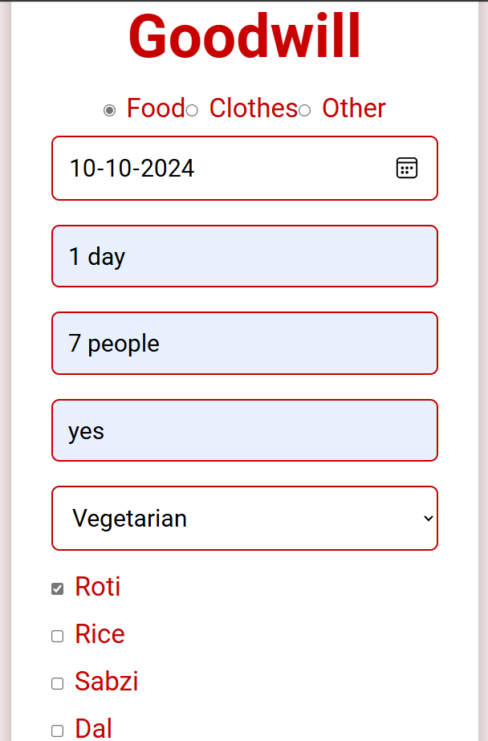
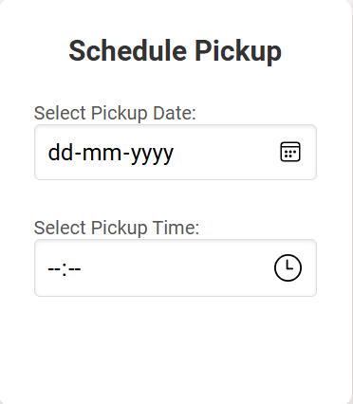
Type of donation
Pickup page

Slide 11
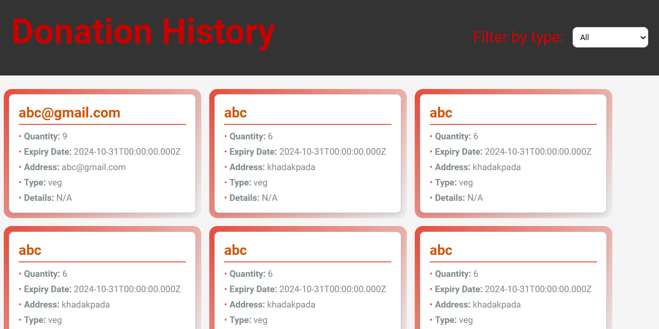
History page

Slide 12
Conclusion
Implementing a food waste management system is crucial for reducing food wastage and aiding disadvantaged communities. This system facilitates the seamless donation of surplus food from sources like restaurants, events, and canteens to those in need.
By using modern technology and fostering collaboration among donors, receivers, and transport vendors, the system improves the efficiency and transparency of food distribution. It minimizes the environmental impact of food waste and maximizes the use of edible food, helping combat hunger.
Reporting tools and reward mechanisms incentivize donor participation, promoting social responsibility and sustainability. Overall, this system effectively manages surplus food, benefiting both the community and the environment.
The food waste management system is a vital step towards reducing wastage, supporting food security, and promoting sustainable development. Its success can serve as a global model, showcasing technology's role in addressing social and environmental challenges.

